Slide 1
UML Use Case Diagrams
Maciej Kawka,
Radosław Relidzyński

Slide 2
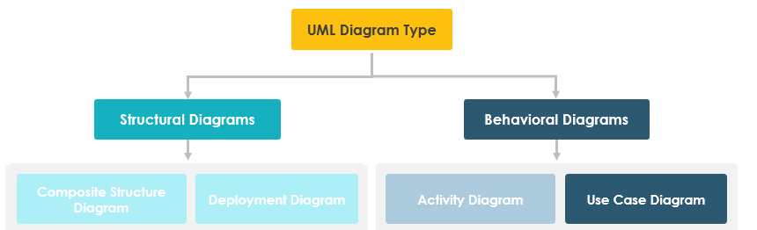
1. Intrudaction: What is use case diagrams?
Use case diagrams are part of UML, whichis standardized modeling language that provides a way to visualize a system architectural blueprints
Represents the interactions (use cases) between the system and its external entities (actors). It is a high-level view of what the system does without getting into impelementation details.

Slide 3
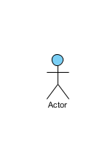
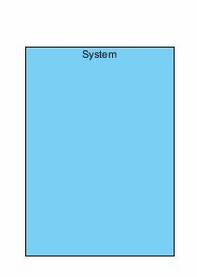
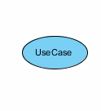
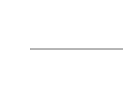
2. UML Diggrams – key Components
Actor: An actor—a noun-defined business role—interacts with system functions by triggering use cases while carrying responsibilities (inputs) and expectations (outputs), unlike a user who may play multiple roles (e.g., a professor acting as both instructor and researcher).
Use Case: A system function—whether automated or manual—is named by a verb plus a noun (or noun phrase, e.g., "Do something"), and while every actor must be linked to a use case, some use cases may stand alone without an actor.
Boundary of system The system boundary, defined as the entire system in the requirements document, can also be applied to individual modules in complex systems—such as an ERP system where modules like personnel, payroll, and accounting each serve as boundaries for specific business functions—while the overall system spans all these modules.
Communication Link An actor's participation in a use case is depicted by a solid link, with associations showing that they communicate via messages.

Slide 4


3. Use Case Relationships
Extends
A dotted directed arrow with its tip pointing to the base use case "Login Account" and labeled with the stereotype "<<extends>>" indicates that the "Invalid Password" use case may, as specified by the extension, include behavior from the base use case.
Include
When a use case incorporates functionality from another as part of its business process flow, the include (or uses) relationship is depicted with a directed, dotted arrow—from the base (parent) use case to the child use case—labeled with the stereotype "<<include>>" to indicate that an instance of the base use case will include the behavior specified in the child use case.
Generalization
A generalization relationship, depicted by a directed arrow with a triangle arrowhead (child at the base and tip pointing to the parent), signifies a parent-child dynamic where the child use case enhances the parent's behavior.

Slide 5
4. Use Case Examples

Slide 6
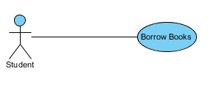
4.1. Use Case Example – Association Link

Slide 7
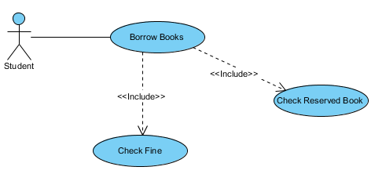
4.2. Use Case Example – Include Relationship

Slide 8
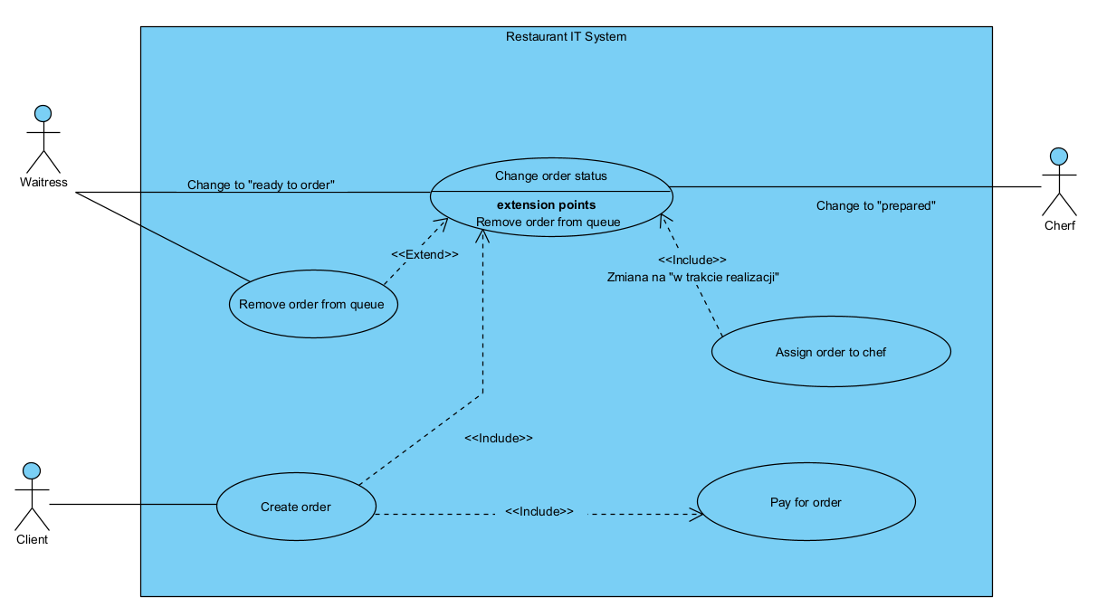
4.2. Use Case Example – Restauration

Slide 9
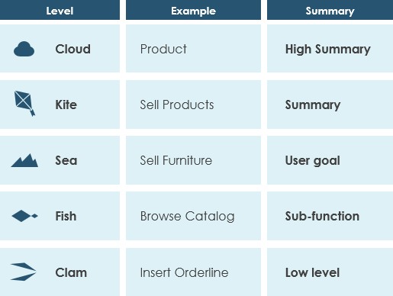
5. Use Case Levels of Details
Use case granularity describes how information is organized and detailed in use case specifications, improving communication and planning between stakeholders and developers—a concept Alastair Cockburn illustrates in Writing Effective Use Cases by likening different goal levels to the varying depths of the sea.

Slide 10
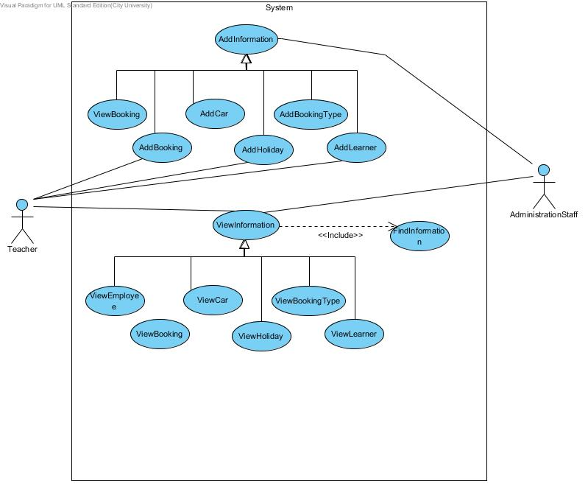
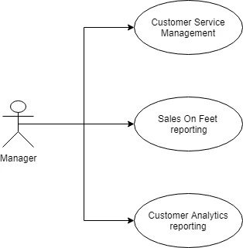
6. Use Case – Common mistakes
Too many details
Confusing System Modules with Use Cases
Use case models in general, are developed to help stakeholders in understanding system functionality and features. It’s not a playground or a showcase of your skills.
The system modules or functional modules are not used as case candidates.

Slide 11
Bibliography
https://stackoverflow.com/questions/13938906/too-many-use-cases-in-use-case-diagram-cant-fit-boundary-any-way-of-simplify
https://techcanvass.com/blogs/top-use-case-mistakes-to-avoid.aspx?srsltid=AfmBOoqDYdMR2f4uPZYL9JuzNE9CiYX1F0FawQl37z1TJdFAzIZX8IYQ
https://knowhow.visual-paradigm.com/uml/10-use-case-diagram-tips/
https://www.visual-paradigm.com/guide/uml-unified-modeling-language/what-is-use-case-diagram/
https://www.lucidchart.com/pages/uml-use-case-diagram

Slide 12
Thank You for Your attention

